Slide 1
Photo Appropriation
Chever Marq Roldan
Source artwork: Johannes Vermeer, The Geographer (1669)

Slide 2
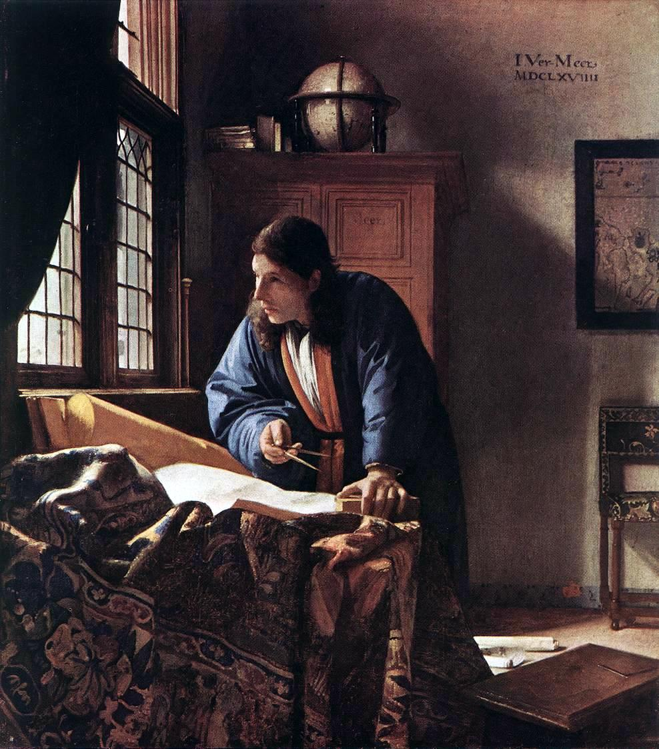
Source Artwork
Title: The Geographer
Artist: Johannes Vermeer
Year: 1669
Medium: Oil on canvas
Dimensions: 51.6 x 45.4 cm
Collection: Städel Museum, Frankfurt
Source details: Städel Museum Digital Collection. Image: Wikimedia Commons public-domain reproduction.

Slide 3
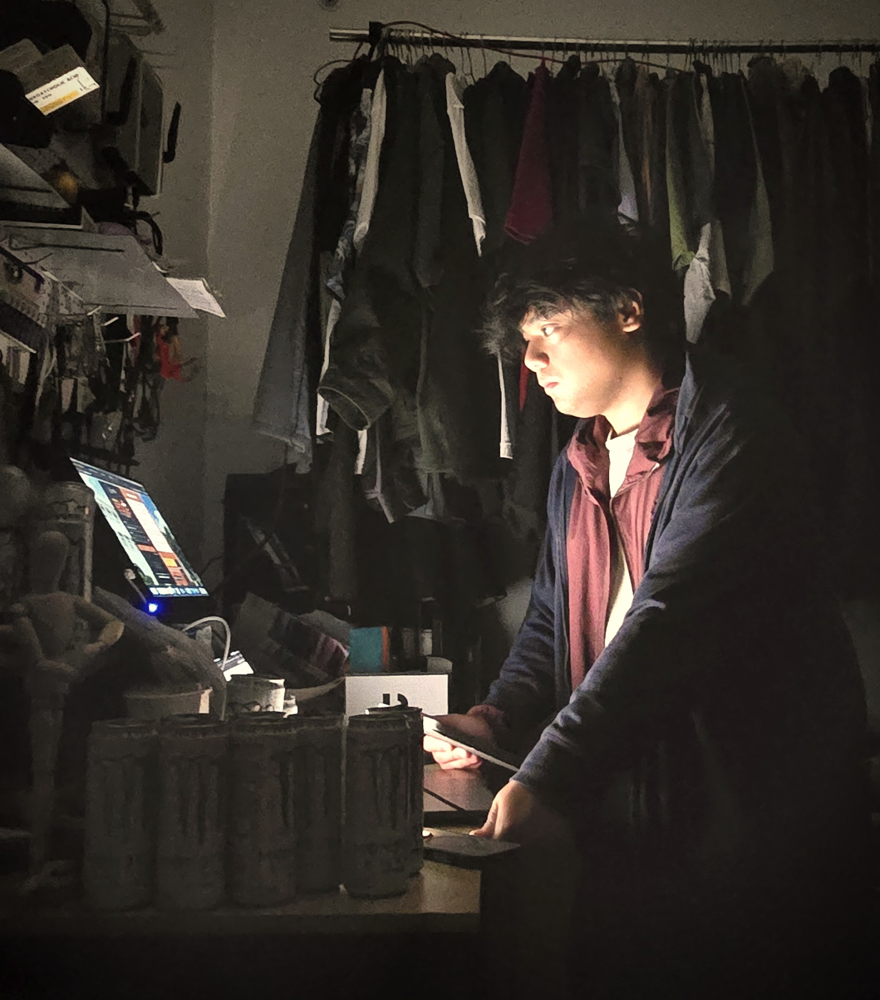
Your Appropriation
Title: The Modern Window
Artist: Chever Marq Roldan
Year: 2026
Medium: Digital photograph

Slide 4
Comparison
Original: The Geographer
Appropriation: The Modern Window

Slide 5
Explanation
Appropriation Type
I mainly appropriated the pose/motif and content of Vermeer’s The Geographer. I kept the idea of a person working while looking toward a window, but translated it into a modern work setup.
What stayed recognizeable?
I kept the red-and-blue clothing, the desk, the leaning pose, and the direction of the gaze. I also tried to preserve the moment of looking toward a window, even if my version becomes clearer when placed beside the original.
What changed?
The maps, globe, and work tools were replaced by screens, a laptop/monitor, and energy drinks. Natural window light is replaced by screen light, and the space feels more cramped than Vermeer’s spacious room.
Issue or Advocacy
The work comments on constant work, productivity culture, and information overload. Technology is not shown as harmful by itself, but modern life can keep us so absorbed in screens and tasks that we forget to slow down, look outside, and remember that we work to live—not live to work.

